Slide 1

Project Proposal
Network Performance Evaluation
of Linux Based Operating Systems
Team Physical Environment
CLIENT: DR RAYMOND LUTUI
MENTOR: DANIEL VAIPULU

Slide 3
Executive summary
The project compares the network performance of three Linux distributions: Ubuntu, Fedora, and Kali Linux. The project will concentrate on IPv4 and IPv6, utilizing both TCP and UDP protocols. Performance indicators include throughput, latency, packet loss, and jitter. Data on critical metrics will be collected using tools such as iPerf and D-ITG. The project's goal is to provide insights into picking the best Linux distribution for various network settings.
Can combine Summary and Rationale*

Slide 4
Project objectives
Evaluate Ubuntu, Fedora, and Kali Linux on IPv4 and IPv6 using both TCP and UDP.
Tool Integration: Use networking tools such as iPerf and D-ITG to collect accurate performance data on the four matrices: throughput, latency, packet loss, and jitter
Automation: Write scripts to automate performance testing and data collection.
Client Feedback: Regularly show outcomes to the client to ensure that the project meets their expectations.

Slide 5
Project scope
Operating Systems Evaluated: Ubuntu, Fedora, and Kali Linux. Network evaluation includes evaluating IPv4 and IPv6, as well as TCP and UDP protocols.
Performance Metrics: Consider throughput, latency, and packet loss across different operating systems.
Tools used for performance evaluation include iPerf and D-ITG.
Timeline: Evaluation and reporting throughout three main revisions (Ubuntu, Fedora, and Kali).

Slide 6
Project management methodology
Hybrid Approach: A combination of Waterfall and Agile methods.
Phases 1, 2, and 3 (Waterfall) include initial planning, investigation, and analysis.
Phases 4 and 5 (Scrum) include setting up evaluation environment, evaluation execution, and feedback for each Linux distribution (Ubuntu, Fedora, and Kali).
Phase 6 (Waterfall) includes compiling and comparing results of evaluation and documenting closure report.
Benefits include combining organized project planning with flexible iterative testing to ensure thorough review and timely adjustments.

Slide 7
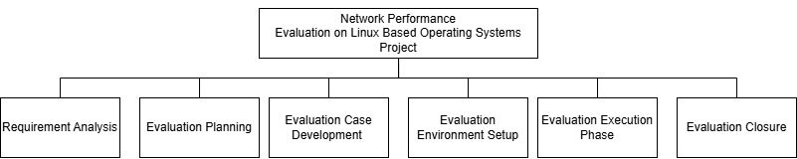
Project Plan
Date | Milestone Type | Milestone
04/04/2025 | External | Project Proposal Submission
06/06/2025 | External | Mid-Term Review
17/08/2025 | Internal | Completion of Ubuntu Evaluation
14/09/2025 | Internal | Completion of Fedora Evaluation
12/10/2025 | Internal | Completion of Kali Evaluation
31/10/2025 | External | Final Poster
31/10/2025 | Internal | Portfolio
Start 03 Mar 2025
Milestone 1 04 Apr 2025
Milestone 2 06 June 2025
Milestone 3 31 Oct 2025

Slide 8
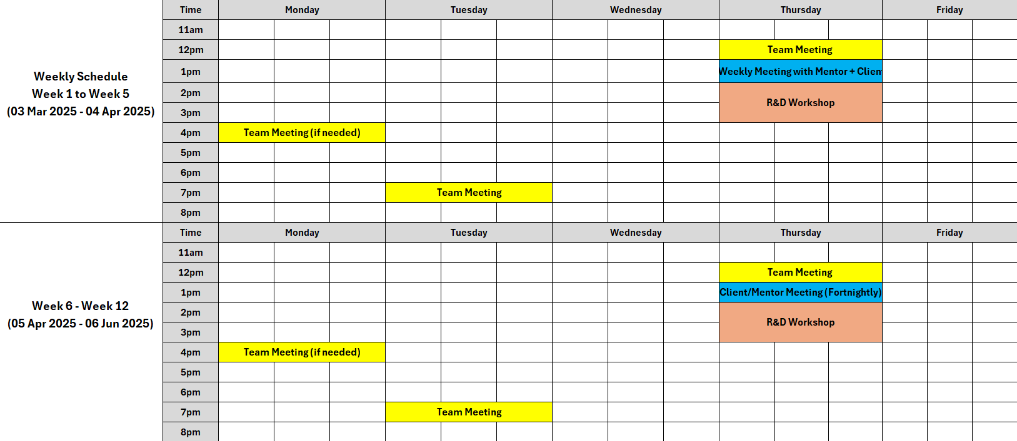
Team contract & schedule
Member Name | Team Role | Assigned IP Version
Thomas Robinson | Project Manager | IPv4
Win Phyo | System Architect | IPv4
Zafar Afrad | Network Engineer | IPv4
Kylie Afable | Network Engineer | IPv6
Larissa Goh | Network Engineer | IPv6
Nathan Quai Hoi | System Architect | IPv6
Charmi Patel | Network Engineer | IPv6

Slide 9
Risks
Logged in the Risk Register, with mitigation and owners assigned
Our risk management plan suits our STLC methodology.
Risks are identified and during the requirements analysis phase
Logged in the Risk Register
Reviewed in weekly meetings
Ensures the team stays flexible during analysis & development phases
Key Project Risks:
Tool Compatibility Issues
D-ITG may not work on Fedora.
2. Router Misconfiguration Incorrect Linux router setup could impact results.

Slide 10
Issues
If a risk occurs, it’s moved into the issue register
Unexpected challenges are added straight into the issue register

Slide 11
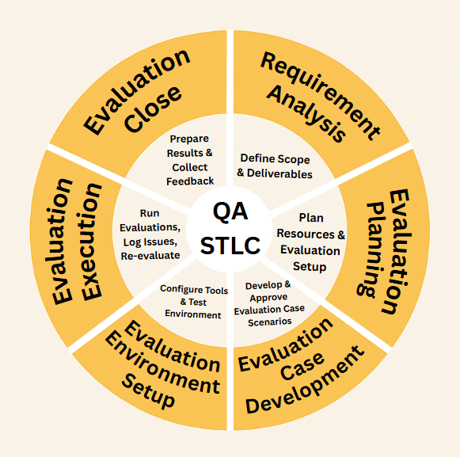
Quality assurance plan

Slide 12
ESTIMATED COSTS
Cost Category | Description | Total Cost (NZD)
Hardware | Computers, Monitors, Laptops, Mouse and Keyboards | $16,152.16
Labour | Mentor, Project Manager, System Architect, and Network Engineer average salary | $109,420.80
Network Equipment | Network Cards, Ethernet Cable | $148.35
Software Tools | IPerf, D-ITG | $0
Total Estimated Cost |  | $125,721.31

Slide 13
Labour Breakdown
Role | Cost Breakdown | Average pay per hour (inc. GST) | Total Hours | Total Cost (NZD)
Mentor | Provided by AUT: $142+GST | $163.30 | 1 hour per week 24 weeks (2 sems) 1 x 24 = 24 hrs | 163.30 x 24 = $3,919.20
Project Manager | Average yearly salary: $98,461 (PayScale, 2025) | $47.34 | 15 hours per week 24 weeks (2 sems) 15 x 24 = 360 hrs | 360 x 47.24 = $17,006.40
Network Engineer (x4) | Average yearly salary: $78,377 (PayScale, 2024) | $37.68 | 15 hours per week 24 weeks (2 sems) 15 x 24 = 360 360 x 4 = 1440 hrs | 1440 x 37.68 = $54,259.20
System Architect (x2) | Average yearly salary: $98,895 (PayScale, 2023) | $47.55 | 15 hours per week 24 weeks (2 sems) 15 x 24 = 360 hrs 360 x 2 = 720 hrs | 720 x 47.55 = $34,236.00
Total Cost |  |  |  | $109,420.80

Slide 14

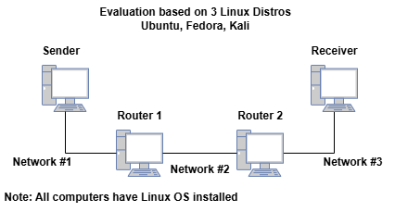
Project feasibility
Tools and Technology:
OS = Ubuntu, Fedora, Kali Linux
Network Tools = iPerf (tests IPv4 and IPv6 using TCP and UDP)
Packet Sizes = 12 variations of packet sizes
Required Skills Needed:
Familiarity with Linux, software routing, and performance testing.
IPv4 and IPv6 network principles
Programming and debugging
Router configuration
Required Infrastructure:

Slide 15
UpSKILLING
Required Skills Needed:
Familiarity with Linux, software routing, and performance testing.
IPv4 and IPv6 network principles
Programming and debugging
Router configuration
Hi Charmi, We are using a different powerpoint Slide

Slide 16
Questions?

Slide 17
REFERENCES
PayScale. (2023, October 19). Average Systems Architect Salary in New Zealand. https://www.payscale.com/research/NZ/Job=Systems_Architect/Salary
PB Technologies. (n.d.). Supermicro 521R-T Mini Server - 1x Xeon E-2434 4C/8T 3.4GHz, 16GB RAM ... ( SVRSPM34170 ). https://www.pbtech.co.nz/product/SVRSPM34170/Supermicro-521R-T-Mini-Server---1x-Xeon-E-2434-4C8
PB Technologies. (n.d.). ASUS Vivobook Go 15 L510KA 15.6" FHD Intel Pentium Silver N6000 - 8GB... ( L510KA-EJ599W ). https://www.pbtech.co.nz/product/NBKASU510599/ASUS-Vivobook-Go-15-L510KA-156-FHD-Intel-Pentium-S
PB Technologies. (n.d.). Philips 243V7QJAB/79 24" FHD Monitor. https://www.pbtech.co.nz/product/MONPHS2438/Philips-243V7QJAB79-24-FHD-Monitor-1920x1080---IPS
PB Technologies. (n.d.). A4Tech Fstyler F1010 Multimedia Keyboard & Mouse Combo USB Wired -... ( F1010 ). https://www.pbtech.co.nz/product/KEYA4T1001/A4Tech-Fstyler-F1010-Multimedia-Keyboard--Mouse-Co
PB Technologies. (n.d.). Cruxtec 0.5m Cat7 Ethernet Cable - Black Color -- 10Gb / SFTP Triple... ( RS7-005-BK ). https://www.pbtech.co.nz/product/CABCXT920050/Cruxtec-05m-Cat7-Ethernet-Cable---Black-Color----1
PB Technologies. (n.d.). TP-Link TG-3468 32-bit Gigabit PCIe Network Adapter, Realtek RTL8168B... ( TG-3468 ). https://www.pbtech.co.nz/product/NETTPL3468/TP-Link-TG-3468-32-bit-Gigabit-PCIe-Network-Adapte
Quintero, A., Sans, F., & Gamess, E. (2016). Performance evaluation of IPv4/IPv6 transition mechanisms. International Journal of Computer Network and Information Security, 8(2), 1–14. https://doi.org/10.5815/ijcnis.2016.02.01
Taffer, M. (2024, December 9). Lean Project Management: Definition, Principles, & Drawbacks. The Digital Project Manager. https://thedigitalprojectmanager.com/projects/pm-methodology/lean-project-management/
Atlassian. (n.d.). Waterfall Methodology: A Comprehensive Guide. https://www.atlassian.com/agile/project-management/waterfall-methodology
Chandra, D. G., Kathing, M., & Kumar, D. P. (2013). A Comparative Study on IPv4 and IPv6. 2013 International Conference on Communication Systems and Network Technologies, 286-289. http://doi.org/10.1109/CSNT.2013.67
Gamess, E., & Velásquez, K. (2008). IPv4 and IPv6 Forwarding Performance Evaluation on Different Operating Systems. CLEI. https://clei.org/proceedings_data/CLEI2008/Anales/pdf/CLEI/CLEI_2008_118.pdf
Katalon. (n.d.). Software Testing Life Cycle: A Definitive Guide. Katalon. https://katalon.com/resources-center/blog/software-testing-life-cycle
Laoyan, S. (2025, February 20). What is agile methodology? (A beginner’s guide). Asana. https://asana.com/resources/agile-methodology
Narayan, S., Sodhi, S. S., Lutui, P. R., & Vijayakumar, K. J. (2010). Network performance evaluation of routers in IPv4/IPv6 environment. 2010 IEEE International Conference on Wireless Communications, Networking and Information Security, 2, 707–710. https://doi.org/10.1109/WCINS.2010.5541871
PayScale. (2024, May 21). Average Network Engineer Salary in New Zealand. https://www.payscale.com/research/NZ/Job=Network_Engineer/Salary
PayScale. (2025, January 05). Average Project Manager, Information Technology (IT) with Project Management Skills Salary in New Zealand. https://www.payscale.com/research/NZ/Job=Project_Manager%2C_Information_Technology_(IT)/Salary/ac095581/Project-Management

